Slide 1
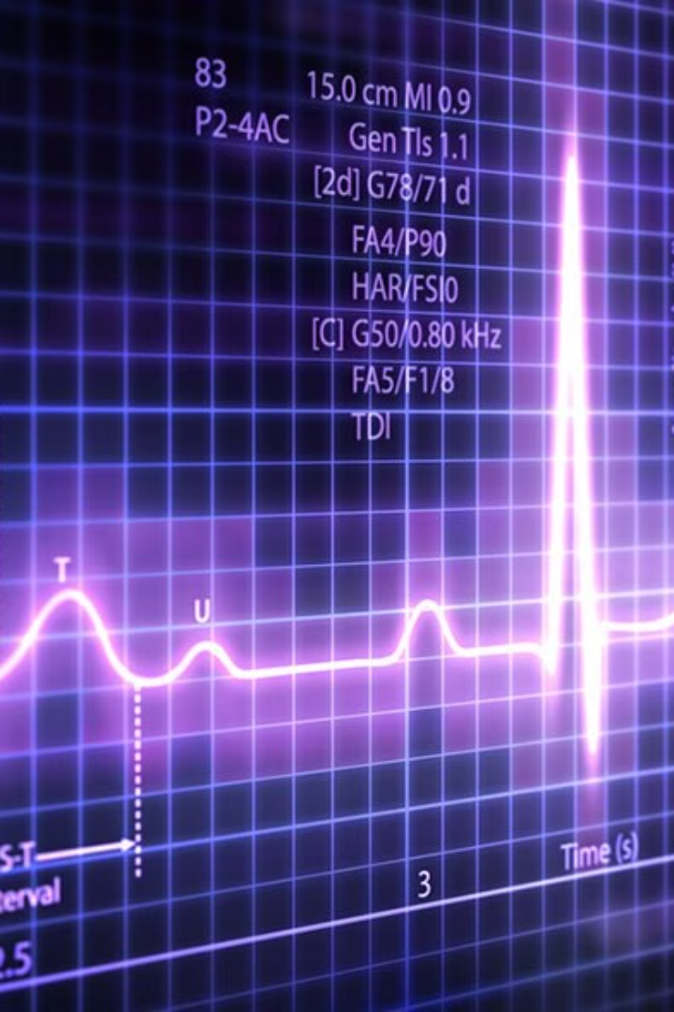
Classification of ECG Signals Using Machine Learning
Presented by: Nawar Alimam, Alhassan Alsaggaf
Instructor: Enfel Barakat, Narjisse Kabbaj Affiliation: Department of Electrical and Computer Engineering, Effat University

Slide 2

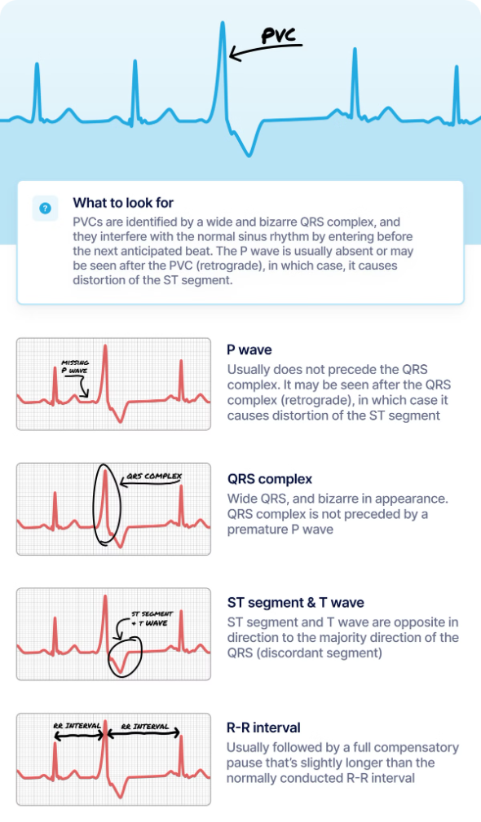
Introduction to Cardiovascular Impact
Cardiovascular Disease
Early Detection
Cardiovascular disease (CVD) is a leading cause of death globally, impacting millions of lives.
Early detection of CVD is crucial for timely intervention and improving patient outcomes.
ECG Signals
Machine Learning
Electrocardiograms (ECGs) provide valuable insights into heart function and can reveal underlying abnormalities.
Machine learning algorithms can analyze ECG signals to identify patterns associated with cardiac disease.

Slide 3





Objectives of the Study
Improve ECG Classification
Address Data Imbalance
Develop a machine learning framework to enhance automated ECG classification for Normal, PVC, AFib, and VTach.
Develop robust models that can handle the imbalanced nature of clinical ECG datasets.
Enhance Diagnostic Accuracy
Optimize Time Efficiency
Aim to achieve high accuracy in classifying arrhythmias, reducing misdiagnosis and improving patient care.
Automate ECG interpretation to expedite diagnosis and minimize manual analysis effort.

Slide 4
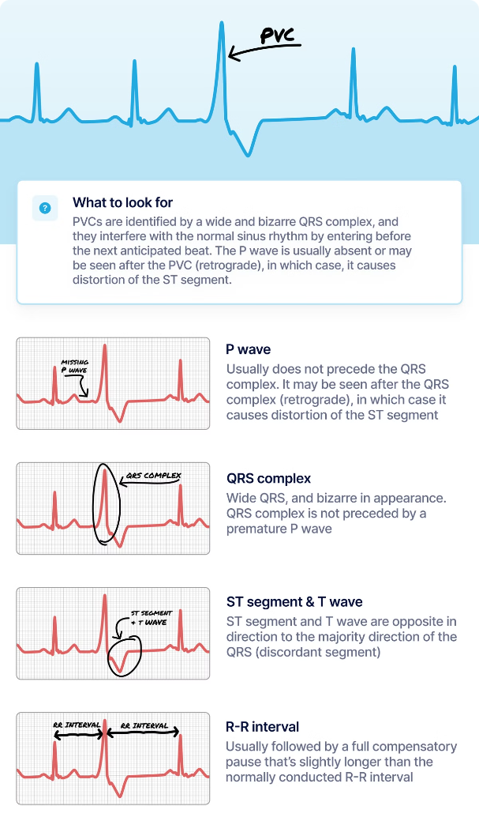
Synthetic Data Generation
This section outlines the process of generating synthetic ECG signals to address data imbalances and improve the detection of arrhythmias such as Premature Ventricular Contraction (PVC), Atrial Fibrillation (AFib), and Ventricular Tachycardia (VTach). The synthetic signals were created using mathematical models that replicate realistic ECG waveforms.
Method
Description
General ECG Signal
Synthesized as a combination of P-wave, QRS complex, and T-wave:
P-Wave
Models atrial depolarization:
QRS Complex
Represents ventricular depolarization:
T-Wave
Models ventricular repolarization:
Arrhythmia Simulation
The synthetic ECG signals also include simulations of common arrhythmias:
PVC (Premature Ventricular Contraction)
AFib (Atrial Fibrillation)
VTach (Ventricular Tachycardia)

Slide 5




Mathematical Modeling of ECG Signals
Normal ECG Signal
Premature Ventricular Contraction (PVC)
Atrial Fibrillation (AFib)
Ventricular Tachycardia (VTach)
The normal ECG signal consists of three distinct waves: the P wave, the QRS complex, and the T wave.
AFib is characterized by a chaotic P wave and irregular R-R intervals, signifying a rapid and irregular heartbeat.
The PVC is characterized by the absence of a P wave and an exaggerated QRS complex.
VTach is a rapid heartbeat originating from the ventricles, characterized by a dominant QRS complex and absent P and T waves.

Slide 6
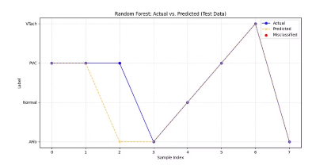
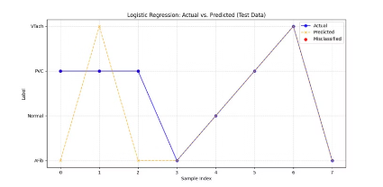
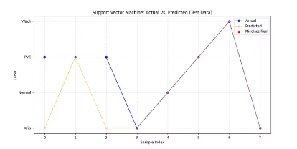
Machine Learning Implementation Details
Dataset
1
Used the MIT-BIH Arrhythmia Database combined with synthetic data generated in MATLAB to address data imbalance.
2
Features
Extracted key ECG features like P-wave amplitude, QRS width, and T-wave frequency from 1-second signal intervals.
Models Tested
3
Random Forest (Best Performance): Achieved 88% accuracy with optimized parameters.
Logistic Regression: Poor fit, achieved 62.5% and struggled with non-linear decision boundaries.
Support Vector Machine (SVM): Achieved 75%, Moderate performance, sensitive to parameter tuning.

Slide 7

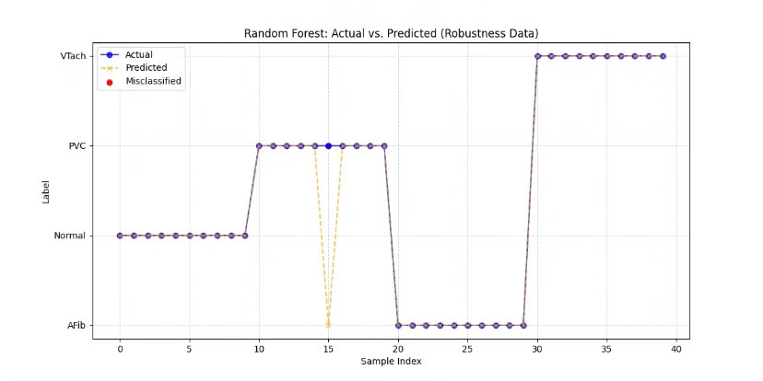
Results
Machine learning Random forest model was evaluated using metrics such as accuracy, precision, and recall.
87.5%
Accuracy
The model correctly identified 87.5% of the ECG signals, showcasing its effectiveness.
97.5%
Generalization
Robust generalization to new data, indicating good performance on new ECG records.
Balanced
Precision/Recall
Precision and recall were balanced across normal and arrhythmic classes.

Slide 8

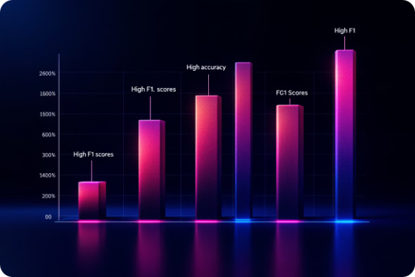
Discussion
Performance Assessment
Model Limitations
The random forest model achieved high accuracy on both the test dataset and a robustness dataset. This indicates that the model is not only accurate but also robust against variations in ECG signal characteristics.
The model showed minor errors in distinguishing PVC from VTach due to similar QRS patterns. This highlights a challenge in classifying closely related ECG abnormalities.
Key metrics such as F1-score are high across all classes, indicating the model's ability to classify different ECG abnormalities effectively.

Slide 9
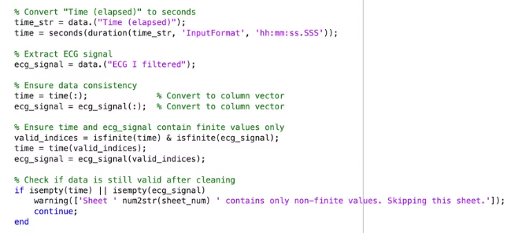
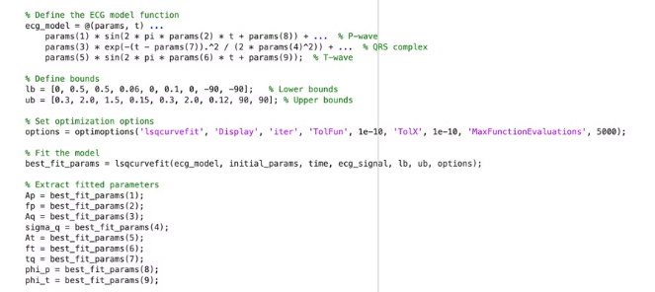
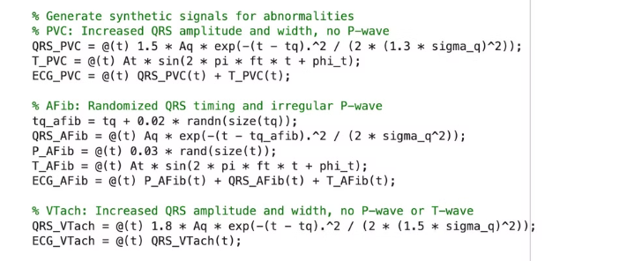
Code Implementation

Slide 10
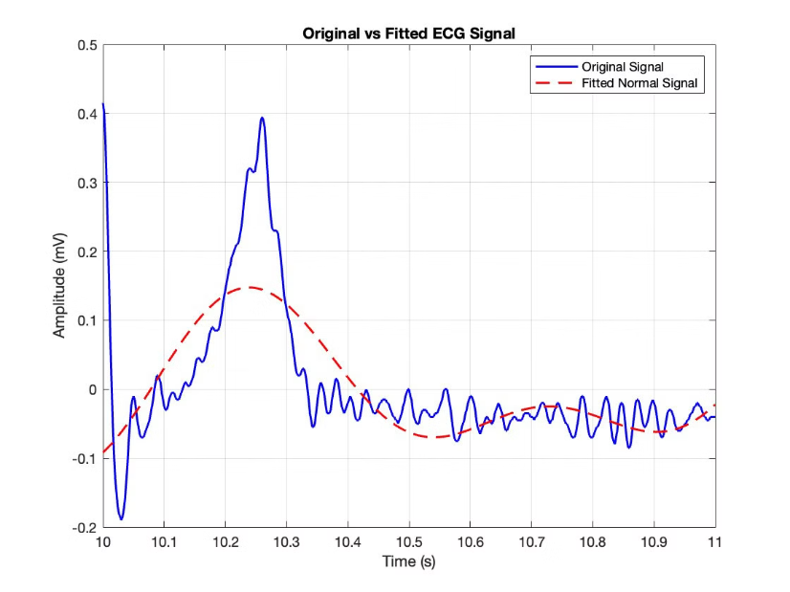
Example output

Slide 11

Future Work Directions
1
Expand Dataset
Include a broader range of arrhythmias for more comprehensive analysis.
2
Deep Learning
Deep learning techniques like CNNs for automated feature extraction and classification.
3
Real-Time Optimization
Make the model faster for use on wearables.
Ensure it works well in telemedicine.

